Slide 1




Introduction to R - 6
Loops and Conditional Statements

Slide 2
Objectives
Recap the skills we have learnt so far in R
Data manipulation
Data Visualisation
Understand conditional statements and loops + how we can use them to make the above code more efficient ☺

Slide 3
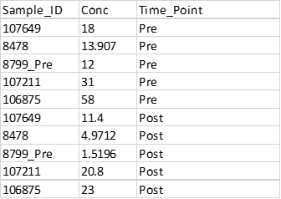
Data Manipulation
Setting up data in long format
Paste transpose (cheating excel version)
dcast:melt or tidyr:gather/tidy
Recoding/renaming variables
as.character()
levels(Df$col_name) <- c(“new var_name 1”, “new_var2”)
Merging data
dplyr:join or data.table:merge
Fixing character data e.g Sample_IDs using stringr and regular expressions
str_replace(string, pattern)
Notes:
Each observation has a separate row

Slide 4
Data Visualisation
Utilised GGPLOT2 make a variety of plots
Ggplot layers +, to build plots; aes(x = y =), colour, shape, labels etc.
Changed colour schemes Pre-built themes Rcolour brewer, Viridis
Changed schemes using colortools and +scale_fill_manual()
GGPUBR Package for boxplots and more!
Adding statistical significance
+stat_compare_means()
Notes:
This is a lot, so today’s script should hopefully be a chance for you to go over these tasks again, whilst building upon them

Slide 5
Controlling your code
So far, we have seen how R can be used to write code that includes functions within an order of operations to execute a task, e.g. calculating the mean or plotting a graph
For example:
Data_frame %>% ggplot(aes(x = titre, y = phago_score)) + geom_boxplot()
Notes:
Could filter df first then plot

Slide 6
Controlling your code
But what if we have lots of data to sort and plot?
It’s not efficient to rewrite your code over and over again
Loops simplify your code, letting you write out your code just once!
The code then recycles through your data over and over again, repeating the functions we determine, until a condition is reached
For every antibody feature (titre, glycosylation levels etc) in our dataframe, plot the feature with phago_score
advanced
Notes:
Instead of writing code for each individual plot
A loop is a programming instruction that repeats until a specific condition is reached.
The loop executes a code block again and again until no further action is required.
Each time the code block within the loop is executed is called an iteration.

Slide 7
For Loop Structure
For loops iterate over a vector – the vector’s job is to tell the loop how many times it needs to repeat
Or vector’s can specify what variables we would like it to repeat over ()
The loop statement { }, contains information about what function we would like to perform
for (variable in vector) {
Perform function on variable
}
Notes:
Vectors are often a sequence of numbers or a sequence of column, specify in brackets

Slide 8
Basic for loops
For every variable in character vector print each variable
for (variable in char_vector) {
print(variable)
}
for (i in char_vector) {
print(i)
}
Shorten using i
Notes:
Like to write out what it is we want to achieve, and what you want repeated
We have a character vector, we want to print out each variable in the vector
I is used to store the variables, doesn’t have to be I could be n,m
I (every instance)
Numeric vector could be a sequence

Slide 9
Explore in R

Slide 10
Loops, inputs and outputs
Often instead of just using print we might want to store the results of loop to a new vector, dataframe, or plot
These are known as outputs
They can be assigned within the loop function using <-
For the output to keep track of where we are in the loop, subset our vector using [i]
R2 Values (output)
0.2
0.3
0.55
0.6
R Values (input)
0.4
0.3
0.55
0.6
Function = ^2
Notes:
Simple print not good enough, this is why I is sometimes referred to as a counter

Slide 11
Explore in R

Slide 12
Conditional loops
For loops continue until the end of the sequence of items in the character/numeric vector or list is reached
We can however, add a conditions to the loop to determine whether or not to perform the loops function, or to stop the loop early
These conditions are based on logical operators such as ==, !=, &, |, <, >
https://www.youtube.com/watch?v=k0xgjUhEG3U

Slide 13
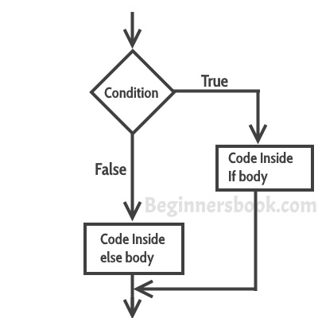
If Else Loops
If a condition is True, perform x function
If it’s False (Else), perform other function
These conditions can also be used to stop a loop early known as a break

Slide 14
Explore in R

Slide 15
Other loop like methods
The apply command in R allows you to apply a function across an array, matrix or data frame.
Apply syntax:
apply(X, # Array, matrix or data frame
MARGIN, # 1: columns, 2: rows, c(1, 2): rows and columns
FUN, # Function to be applied
...) # Additional arguments to FUN
Notes:
Vectorisation is faster, understanding for loops structure however makes learning apply methods easier

Slide 16
Explore in R

Slide 17
Thank you!!

Slide 18
Translating to code
For loops iterate over a vector – the vector’s job is to tell the loop how many times it needs to repeat
Or vector’s can specify what variables we would like it to repeat over
The loop statement { }, contains information about what function we would like to perform
Step 1: Define your vector for the loop
Step 2: Write out loop using designated vector
Example:
col_names <- colnames(dataframe)
For i in col_names {
our dataframe, correlate and plot the feature with phagocytosis
Notes:
Vectors are often a sequence of numbers or a sequence of column names

Slide 19
Basic structure of a For Loop
for (variable in collection) {
Perform function on variable
}

Slide 20
Example:
For loops are the most simple
These iterate (run) over a vector. The vector defines for how long to run the loop for. The for loop code defines what functions we would like to run and what
For(i in column_names) {ggplot(data_frame, aes(x=i, y = phago_score))}

